Slide 1



Never Start from Scratch: Expediting On-Device LLM Personalization via Explainable Model Selection
Haoming Wang, Boyuan Yang, Xiangyu Yin, and Wei Gao
University of Pittsburgh
ACM MobiSys 2025
Notes:
Hi everyone. I am Haoming Wang from University of Pittsburgh. It’s my pleasure to present our work, “Never Start from Scratch: Expediting On-Device LLM Personalization via Explainable Model Selection”. This is a joint work with Boyuan Yang, Xiangyu Yin and my advisor Dr. Wei Gao

Slide 2



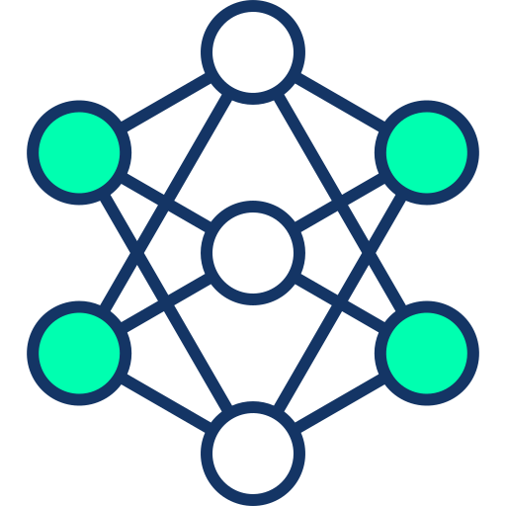


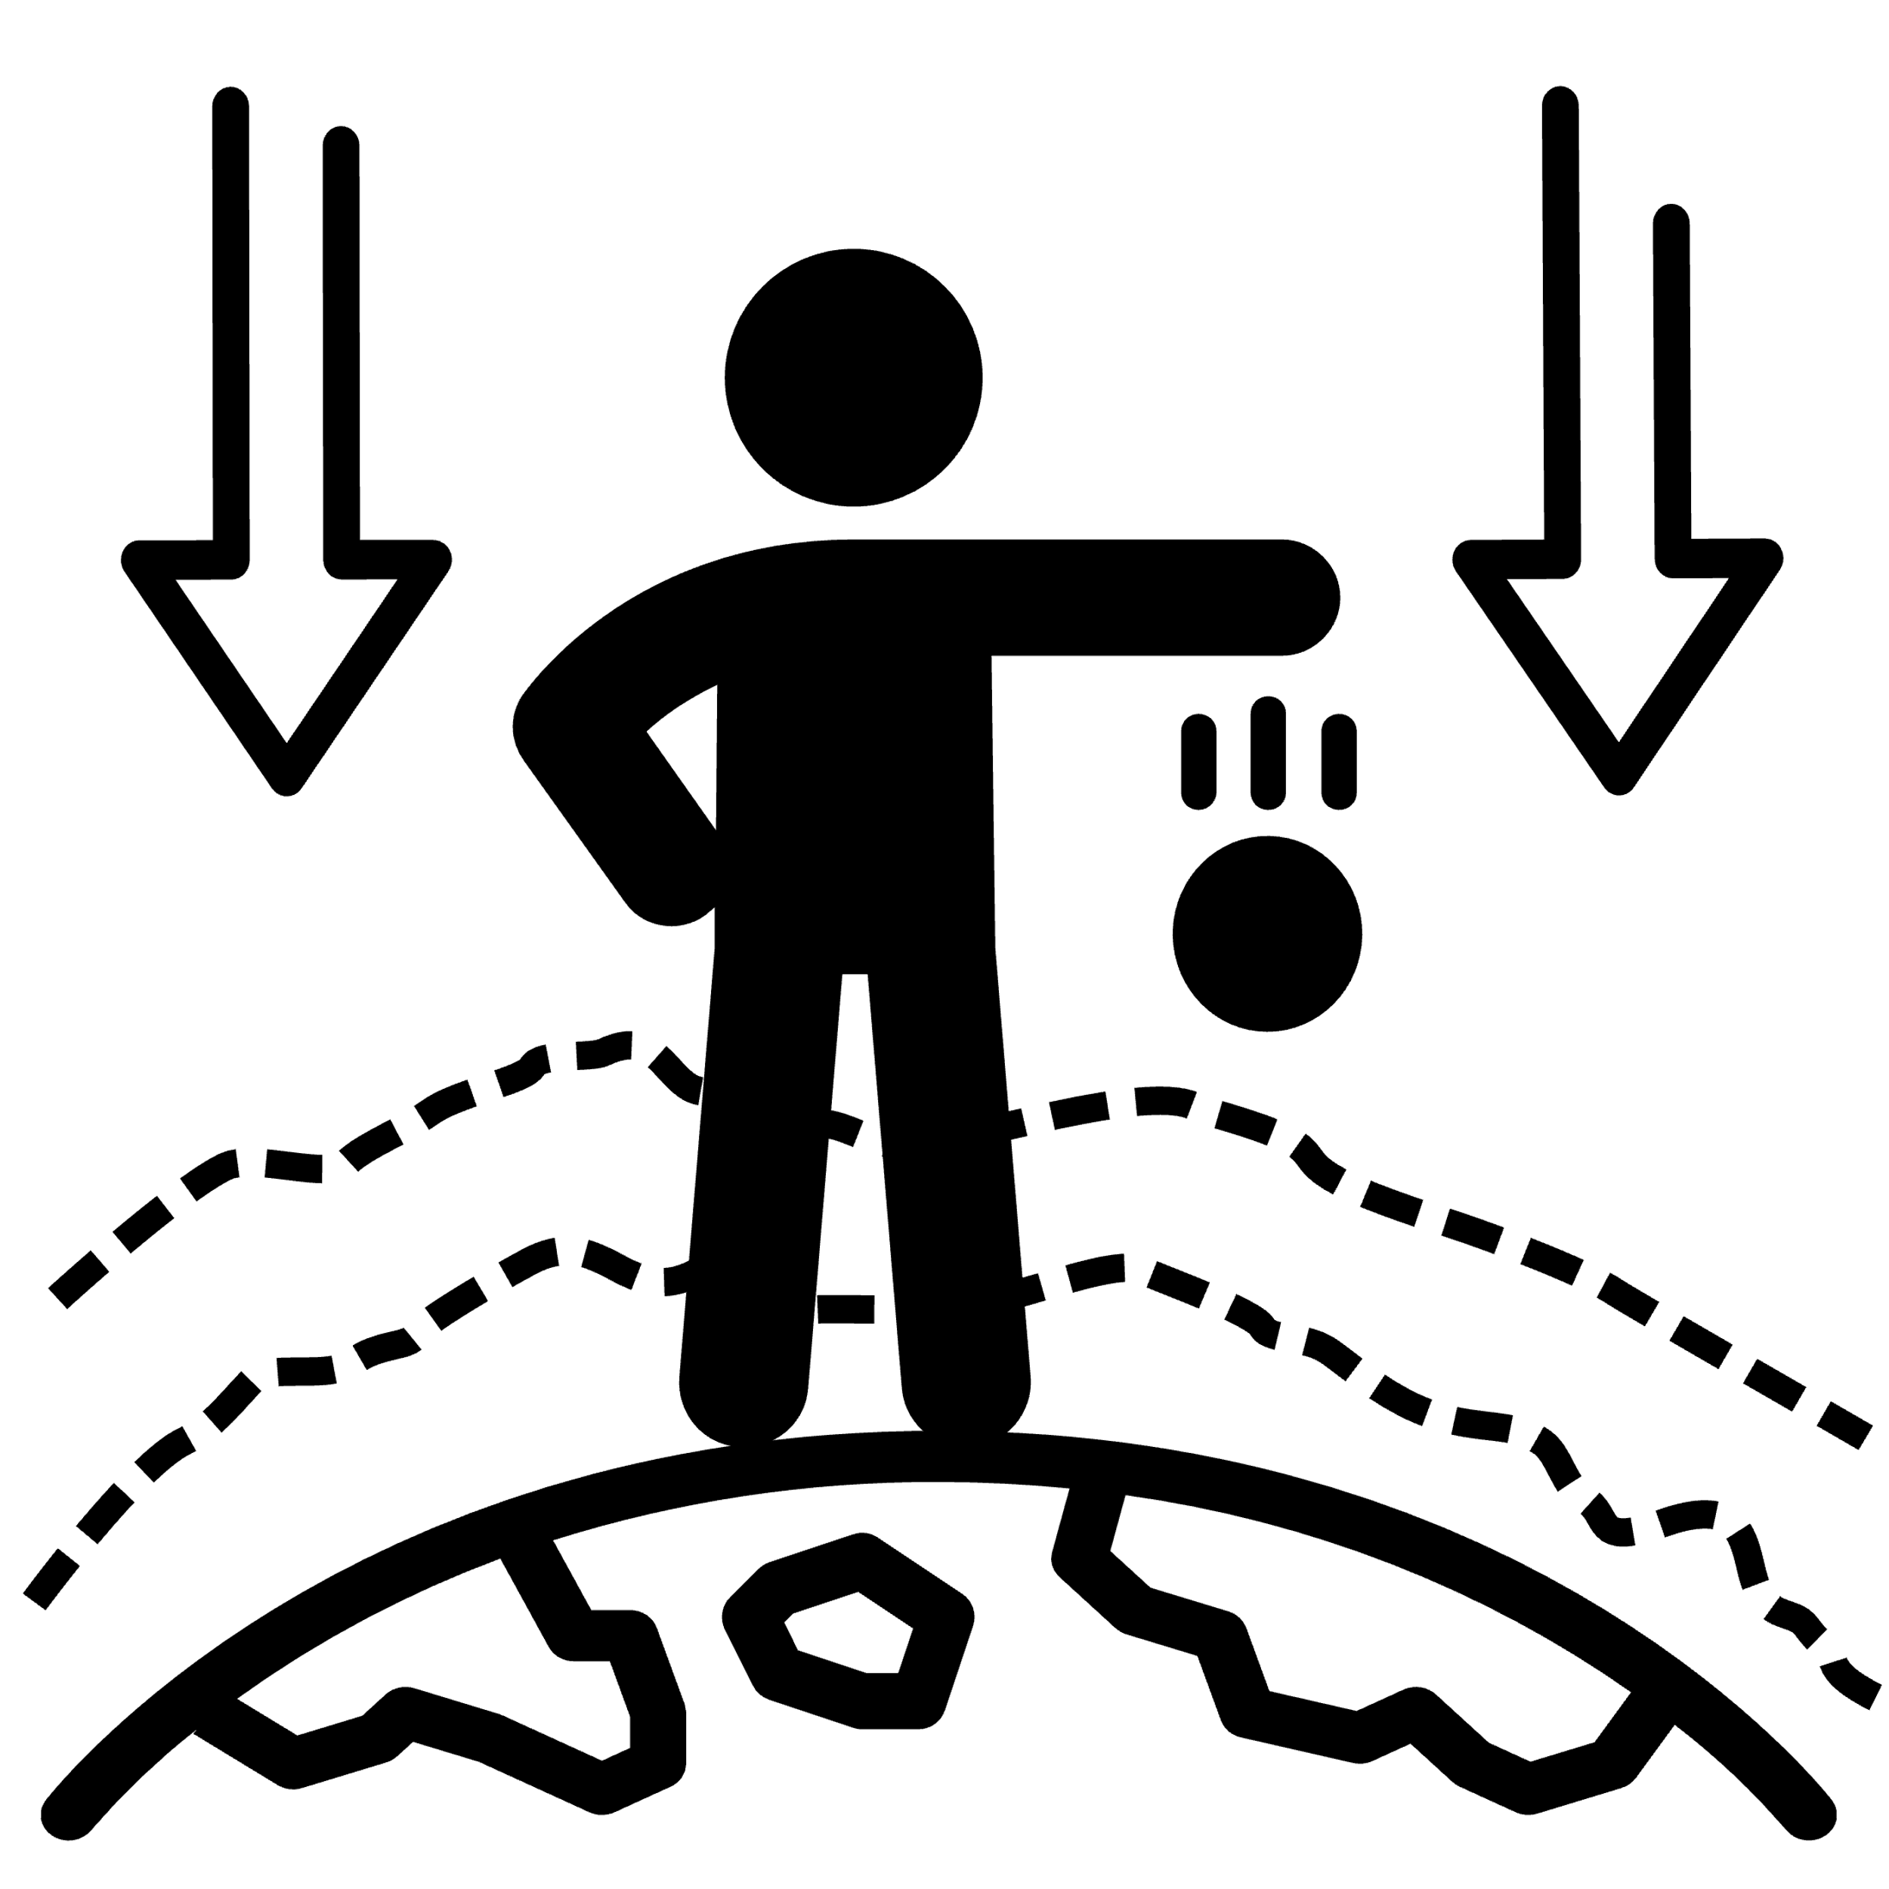



LLM personalization on Mobile Devices
Personalized LLM
Fine-tune
Personal data
Q: what is gravity?
Personalized
Assistant
Personalized Tutor
Elementary student:
- Let me fix that.
- Need help?
Daily communication
Graduate student:
- I will handle the necessary adjustments.
- Is there anything I can assist you with?
Business Scenario
Notes:
With the growing capabilities of large language models, we’re seeing a wide range of intelligent applications emerge.
To better meet the unique needs of individual mobile users, LLM personalization is becoming increasingly important. This is often achieved by fine-tuning the model using personal data generated directly on the user’s device.
For example, a personalized LLM could be an assistant adapted to the user’s habits and preferences across different contexts.
It could also serve as a tutor that aligns with a student’s individual learning style.

Slide 3




Existing Solutions
Upload user data to the cloud
Fine-tune LLM at the local device
Upload data
Fine-tune
User data
User end
User data
Base LLM
Fine-tune
Personalized
LLM
How to address such on-device challenges?
Cloud
Sever
Personalized LLM
User end
Impairing user’s data privacy
Limited compute power
Insufficient personal data
Notes:
A straightforward approach to LLM personalization is to upload a user’s personal data to the cloud, where the model is then fine-tuned.
However, this raises serious privacy concerns, as it involves exposing sensitive user data.
A more privacy-preserving alternative is to perform the fine-tuning directly on the user’s mobile device.
Yet, this on-device approach faces significant challenges due to limited computational resources and the typically small amount of available personal data.
These two challenges in on-device personalization cannot be effectively addressed by simple, existing methods.

Slide 4
On-device personalization challenges
Efficient fine-tuning method
LoRA [1] (Low-Rank Adaptation)
Prompt tuning [2]
…
Not efficient enough
~1 second per training steps on a flagship smartphone
(Qwen2-0.5B on Google Pixel 9 Pro)
Limited compute power
Accumulating enough data
Take very long time
Insufficient personal data
Continual learning [3]
Too expensive for mobile devices
[1] J Lin, et al. Lora: Low-rank adaptation of large language models. ICLR 2022
[2] B Lester, et al. The Power of Scale for Parameter-Efficient Prompt Tuning. Arxiv 2021
[3] A Razdaibiedina, et al. Progressive prompts: Continual learning for language models. ICLR 2023
Notes:
These two challenges in on-device personalization cannot be effectively addressed by simple, existing methods.
First, regarding limited compute power:
Techniques like LoRA can help reduce the computational cost of fine-tuning, but not significantly. They still require backpropagation through the entire model during each training step.
In our experiments, a single training step of fine-tuning the Qwen2-0.5B model on a flagship smartphone take around 1 second.
Second, for the issue of insufficient data:
Fine-tuning typically requires thousands of data samples to avoid bias and overfitting. However, collecting that amount of personal data on-device takes a long time.
While continual learning could allow fine-tuning as new data arrives, it remains too computationally expensive to run efficiently on mobile devices.

Slide 5
Our Solution: Never Start from Scratch!
Initialize personalization from the existing personalized LLMs
Previous users
Personalized LLMs (pLLMs)
Server end:
(1) Personalized LLM pre-cached
on the cloud server
Cloud Sever
pLLM explanations
(2) Pre-compute the explanations for pLLMs
Selection
Model Selection
Model
download
On device :
(3) Select the pLLM that best resembles the personal
data based on the explanations of pLLMs
Personal
data
Current User
Fine-tune
(4) Locally fine-tune the selected pLLM with personal
data
Personalized LLM
Notes:
To overcome these limitations, we take a fundamentally different approach. Rather than fine-tuning from scratch — that is, starting from a general pre-trained base model — we begin fine-tuning from existing personalized models instead.
We begin by assuming that after each user finishes personalizing their model on-device, the resulting personalized model — or “pLLM” — is uploaded and cached on the cloud server.
To support future users, we introduce a new technique that generates lightweight explanations of how each pLLM was fine-tuned. These explanations are designed to be highly compact, keeping communication costs low when transmitted to user devices.
When a new user initiates on-device personalization, instead of starting from a generic base model, their device first downloads these explanations and compares them locally with the user’s own data to identify the most relevant pLLM.
Finally, the selected pLLM is downloaded, and fine-tuning continues from this personalized starting point.

Slide 6
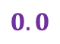
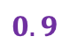
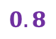
Our Solution: Never Start from Scratch!
Requirements for pLLM explanations:
Explainable: in natural language to ensure
users’ trust
Quantitative: facilitate model selection
Previous users
Personalized LLMs (pLLMs)
Cloud Sever
Format of explanations:
pLLM explanations
Selection
$$0.8$$
Model Selection
Concise
Got it, thanks!
Can’t make it today.
I’m in.
….
0
$$0.9$$
1
Model
download
Informal
Personal
data
0
$$0.0$$
1
Poetic
0
1
……
……
Current User
Fine-tune
Personalized messages
Quantitative explanation
Personalized LLM
Notes:
The effectiveness of our framework depends on accurate model selection. To ensure this accuracy, the explanations provided for the cached pLLMs must meet two key requirements:
First, to build user trust in on-device model personalization, the explanation should clearly describe how the pLLMs were fine-tuned, using natural language.
Second, to support automated model selection, the explanation should include quantitative metrics that measure the difference among pLLMs
To achieve both goals, we design the explanation format by breaking down the language style of each pLLM into several orthogonal dimensions. For each dimension, we provide a concise natural language description along with a numerical value that reflects the pLLM’s characteristics in that aspect.

Slide 7
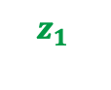
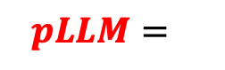
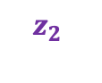
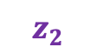
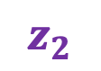

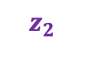
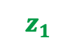
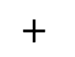
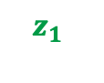
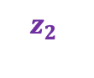
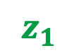
eXplainable Personalized Tuning (XPerT)
Base LLM
Personal data
pLLM
…
Differences
$$z_{1}$$
$$z_{2}$$
…
Proposed by the same model
1
Summarization LLM
3
Map
Model Selection
pLLM 1
$$z_{1}$$
2
Decompose
…
…
$$z_{1}$$
$$z_{2}$$
$$pLLM=$$
Concise
$$+$$
Formal
$$z_{1}$$
$$z_{2}$$
…
$$z_{2}$$
pLLM 2
Embedding space
…
$$z_{1}$$
$$z_{2}$$
…
Server
Device
Notes:
To achieve model selection with explainability mentioned above, we introduce XPerT— eXplainable Personalized Tuning. Here's an overview of how XPerT works.
First, for each pLLM, we compare its output to that of a base model. With the help of a summarization LLM, we then map the difference between their outputs into a vector in the summarization model’s embedding space.
Second, we aim to make this embedding vector interpretable. Based on the linear representation hypothesis, we decompose the embedding into a set of orthogonal sub-vectors. As shown in the figure, each sub-vector comes with a concise natural language description, and the corresponding coefficient in the decomposition serves as a quantitative metric for that dimension. This entire set of interpretable sub-vectors is also generated by the summarization model.
Finally, the user device downloads the explanations for all available pLLMs and compares them with the explanation derived from the user's own local data. The pLLM with the most similar explanation is then selected.
In the following slides, I'll walk through the technical details of these three steps.

Slide 8
XPerT: ① Mapping differences to Embedding space
Base LLM
Personal data
pLLM
…
Differences
$$z_{1}$$
$$z_{2}$$
…
Proposed by the same model
1
Summarization LLM
3
Map
Model
Selection
pLLM 1
$$z_{1}$$
2
Decompose
…
…
$$z_{1}$$
$$z_{2}$$
$$pLLM=$$
Concise
$$+$$
Formal
$$z_{1}$$
$$z_{2}$$
…
$$z_{2}$$
pLLM 2
Embedding space
…
$$z_{1}$$
$$z_{2}$$
…
Server
Device

Slide 9
XPerT: ① Mapping Differences to Embedding Space
Prompt samples
Base LLM
which language style is more characteristic of
<Unstylized output>
than
<Personalized output>
Reply with only one adjective
Base LLM
pLLM
pLLM
Unstylized
output
Personalized
output
Differences
1
Summarization LLM
Instruction
Map
Summarization LLM
Base Layers
Embedding space
Averaged over multiple inferences
Embedding space
Output Layer
Embedding of next token
Notes:
The first step is mapping the output differences to the embedding space. This diagram shows a more detailed flow of the process.
We start by prompting both the base model and the pLLM with the same input. Then, we use a separate summarization model to describe the difference in their output distributions, as guided by a carefully designed instruction.
Instead of using the summarization model’s final output, we extract the embedding vector from its hidden states—specifically, right before the output layer. So that the summarized difference can be quantified.
In the instruction, we ask the summarization model to respond with only one adjective. This way, the difference between the two models is captured in the embedding of the first token.
We repeat this process multiple times, and finally, we average the resulting embeddings to obtain a stable and representative vector.

Slide 10
XPerT: ② Decomposing the Embedding
Base LLM
Personal data
pLLM
…
Differences
$$z_{1}$$
$$z_{2}$$
…
Proposed by the same model
1
Summarization LLM
Map
Most similar
3
Steps of decomposition:
pLLM1
2
1 Propose candidate natural language explanations:
…
$$z_{1}$$
Decompose
…
…
Formal
Concise
$$z_{1}$$
$$z_{2}$$
$$pLLM=$$
Concise
$$+$$
Formal
$$z_{1}$$
$$z_{2}$$
…
$$z_{2}$$
2 Compute embeddings for each candidate:
pLLM2
Embedding space
…
…
$$z_{1}$$
$$z_{2}$$
…
3 Repeat until decomposition error is small enough
Server
Device

Slide 11
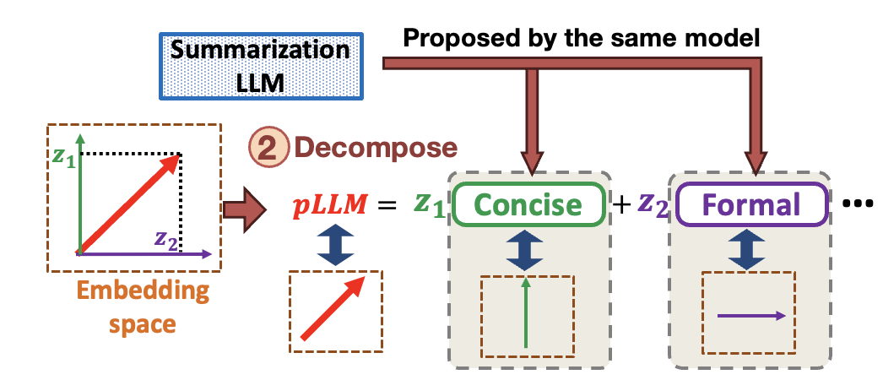
XPerT: ② Decomposing the Embedding
Summarization LLM
Base Layers
Embedding space
Output Layers
Steps of decomposition:
Finish generation
1 Propose candidate natural language explanations:
…
Concise
Formal
Concise
0.32
2 Compute embeddings for each candidate:
Formal
0.11
…
…
…
Next words and probabilities
3 Repeat until decomposition error is small enough
Notes:
The second step is decomposing the embedding, and it involves three parts.
First, in the previous step, we stopped at the hidden layer of the summarization model. Now, we let the model finish its generation. This gives us a list of possible next words, along with their probabilities. These words serve as candidates for natural language explanations.

Slide 12

XPerT: ② Decomposing the Embedding
Concise
Summarization LLM
“concise” style text
unstylized text
Steps of decomposition:
Summarization LLM
1 Propose candidate natural language explanations:
…
Concise
Formal
①Map
2 Compute embeddings for each candidate:
…
Inefficient
3 Repeat until decomposition error is small enough
Notes:
Next, we need to compute the embedding for each candidate. A straightforward idea is to ask the summarization model to generate synthetic text that reflects the style of each candidate. Then, we can use the same method from step one to convert the difference in text into an embedding.
However, this approach is very inefficient—it would require running inference many times, once for each candidate.
We noticed that in the original method, the embedding vector comes entirely from the summarization model’s internal knowledge.

Slide 13

XPerT: ② Decomposing the Embedding
Efficient Method
Concise
Instruction Prompt
Summarization LLM
Steps of decomposition:
1 Propose candidate natural language explanations:
…
Concise
Formal
Error
Feedback
2 Compute embeddings for each candidate:
Ground truth
…
Embedding generated by original inefficient method
3 Repeat until decomposition error is small enough
Notes:
We noticed that in the original method, the embedding vector comes entirely from the summarization model’s internal knowledge.
So instead of delivering that knowledge through stylized texts, we can go one step further. We directly prompt the summarization model to generate a sub-vector from the candidate word itself.
To do this accurately, we need to craft the prompt carefully. We apply offline prompt tuning, where the prompt is treated as trainable embeddings. The sub-vectors generated by the original method serve as ground truth during this tuning.
Once the prompt is optimized, we use it online to generate sub-vectors directly from the candidate words, with much lower overhead.
We keep computing the vector for different candidate until the decomposition error is small enough.

Slide 14
XPerT: ③ On-device Model Selection
Base LLM
Personal data
pLLM
…
Differences
$$z_{1}$$
$$z_{2}$$
…
Proposed by the same model
1
Summarization LLM
Map
Most similar
3
pLLM1
$$z_{1}$$
2
Decompose
…
…
$$z_{1}$$
$$z_{2}$$
$$pLLM=$$
Concise
$$+$$
Formal
$$z_{1}$$
$$z_{2}$$
…
$$z_{2}$$
pLLM2
Embedding space
…
$$z_{1}$$
$$z_{2}$$
…
Server
Device

Slide 15

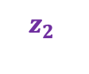




XPerT: ③ On-device Model Selection
Personal data
…
Step 1: Map
Run Step 1 on device
$$z_{1}$$
$$z_{2}$$
…
Most similar
Model partition to fit summarization LLM
into mobile device’s memory
3
pLLM1
…
…
Layer N-1
$$z_{1}$$
$$z_{2}$$
…
pLLM2
Outputs N-1
Layer N
Outputs N
…
On-Device
$$z_{1}$$
$$z_{2}$$
…
Layer N+1
Device
Notes:
The final step is on-device model selection.
After downloading the explanations for all pLLMs, we compute the explanation for the user’s personal data. We do this by repeating the first step: mapping the personal data into an embedding and then decomposing it using the same set of sub-vectors.
But this step requires running the summarization model on the device. Since this model is large, it may exceed the memory limits of mobile devices.
To solve this, we partition the summarization model and run it one layer at a time. The output of each layer is cached and passed to the next.
Because the task only predicts one next token, each layer only needs to be loaded and executed for one time. This significantly reduces the overhead from loading and switching layers.

Slide 16

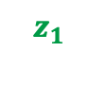

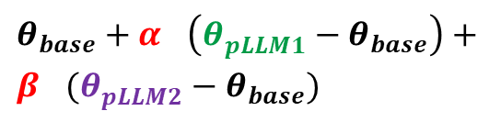

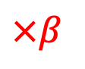
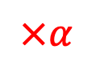
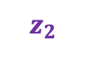

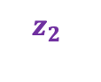
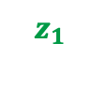

XPerT: ③ On-device selection
Personal data
If such a pLLM doesn’t exist:
…
Personal data
pLLM1
pLLM2
…
…
…
$$z_{1}$$
$$z_{2}$$
…
Most similar
$$z_{2}$$
…
$$z_{1}$$
$$z_{2}$$
…
$$z_{1}$$
$$z_{2}$$
3
$$z_{1}$$
pLLM1
$$×α$$
$$×β$$
…
$$+$$
Try to combine multiple pLLMs to match personal data:
$$z_{1}$$
$$z_{2}$$
…
…
pLLM2
$$z_{1}$$
$$z_{2}$$
…
…
Model merging
$$z_{1}$$
$$z_{2}$$
$θ_{base}+α_{}\left(θ_{pLLM1}^{}−θ_{base}\right)+$ $β_{}(θ_{pLLM2}^{}−θ_{base})$
…
Merged pLLM =
Device
Notes:
In some cases, even the best-matching pLLM may not align well with the user’s personal data.
To address this, we can merge multiple pLLMs, each personalized for different aspects, to better capture the user’s local context.
We start by linearly combining the explanations of several pLLMs to best match the explanation of the user’s personal data.
The coefficients from this combination then guide how we merge the actual models.
Finally, we take the merged model as a starting point and continue with local fine-tuning on the user’s device.

Slide 17







Implementation
Implement LLM Fine-tuning on smartphones:
Android App
API
Convert to model
Download
selected pLLM
On-device training
Generate training artifacts
Online Phase:
Model training as background Android service
Offline Phase:
Convert Model and Data format
Notes:
For implementation, we face a challenge: most existing mobile deep learning frameworks have limited support for fine-tuning LLMs on smartphones.
To make XPerT work, we split the process into two phases.
In the offline phase, we convert the pLLMs from Hugging Face format to ONNX. We also generate all the training artifacts on the server.
Then, in the online phase, the smartphone downloads the selected pLLM and wraps it into an Android app. Using the ONNX Java API, the app launches the model as a background service.

Slide 18
Experiment Settings
Datasets
Synthetic: QA data with diverse language styles generated by ChatGPT
Real-world: Combination of 3 text datasets with multiple language styles
Expertise | elementary / expert
Informativeness | concise / informative
Style | friendly/ unfriendly/ sassy/ sarcastic / persuasive / neutral / poetic
CDS[1] | poetry, lyrics, tweets, Shakespeare
Gutenberg3[2] | fantasy, romance, and sci-fi
ScientificPapers[3] | academic
pLLMs and smartphone models
Llama-3.2-1B on One Plus 12R
Qwen2-0.5B on Pixel 9 Pro
SmolLM-360M on Pixel 7
Baseline Selection Method
Exhaustive Search: evaluates each pLLM’s output with the personal data and selects the best one.
Bayesian Optimization: Frames pLLM selection as a hyperparameter optimized via Bayesian optimization
HyperBand: Leverages the bandit principle to find optimal hyperparameters
[1] K Krishna, et al, Reformulating Unsupervised Style Transfer as Paraphrase Generation. EMNLP2020
[2] R Csaky, et al. The Gutenberg dialogue dataset. Arxiv 2020
[3] A Cohan, et al. A Discourse-Aware Attention Model for Abstractive Summarization of Long Documents. Arxiv 2018
Notes:
n our evaluation, we fine-tune a base LLM into a personalized LLM, using two datasets that feature diverse language styles. For the synthetic dataset, we prompt GPT-4o to generate text in specific language styles, which are characterized along three dimensions shown in the table on the left. To better reflect real-world scenarios, we also construct a real-world dataset by combining several text corpora with distinct styles, as detailed in the table on the right.
We conduct experiments on three smartphone models with varying hardware resources, running LLMs of different sizes according to each device’s memory capacity.
For evaluation, we compare XPerT against training from scratch and three other baseline model selection methods.
The first baseline, Exhaustive Search, just evaluates every pLLM’s output with the personal data and selects the best one. The other two frame model selection as a hyper parameter optimized by Bayesian optimization or bandit principle.

Slide 19
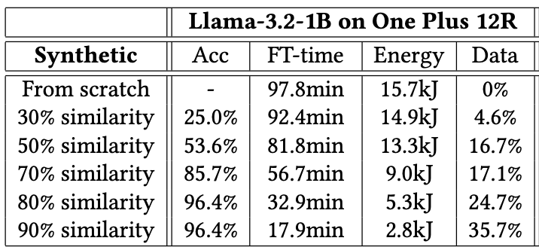
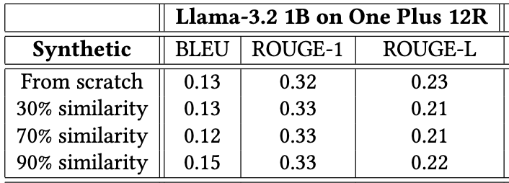
Experiment Results
Comparing with fine-tuning from scratch
Data composition:
Personal data
Stylistic data
FT Data for pLLMs
Correct selection
Default data
Cost of model fine-tuning
Performance of fine-tuned model
reduce computation cost (up to 83%) and improve data efficiency (up to 51%)
without decreasing model performance
Notes:
In our experiments, we simulate different levels of similarity between the on-device personal data and each pLLM.
To do this, we mix default samples—without any specific style—into the pLLMs’ training data. We then define similarity as the percentage of stylized samples in the pLLM’s training data that match the language style of the user’s personal data.
As shown in the left table, XPerT achieves highly accurate model selection when the similarity reaches 70%.
Thanks to this accuracy, XPerT can reduce computation cost by up to 83% and improve data efficiency by up to 51%, compared to fine-tuning from scratch.
In the right table, we see that XPerT also achieves near-identical performance on downstream tasks.
This means we reduce fine-tuning cost without sacrificing performance.

Slide 20
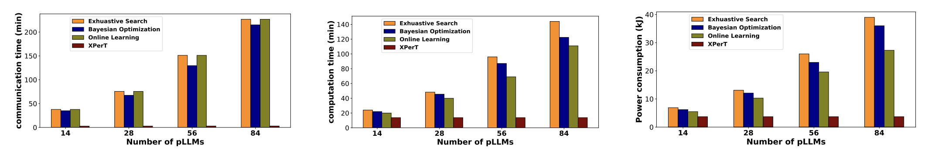
Experiment Results
Comparing with baseline selection methods:
Communication cost
Computation cost
Time consumption
The selection cost of
Baselines: linearly increase with the number of pLLLMs
XPerT: retain a constantly low level
Notes:
When comparing with baseline selection methods, as shown in these figures, we see a clear difference in scalability.
For the baselines, the selection cost increases linearly with the number of pLLMs. This makes them impractical when dealing with a large number of models.
In contrast, XPerT maintains a consistently low selection cost, regardless of the number of pLLMs. This is because the explanations are precomputed on the server, so the device only needs to compare them—no additional inference is required.

Slide 21
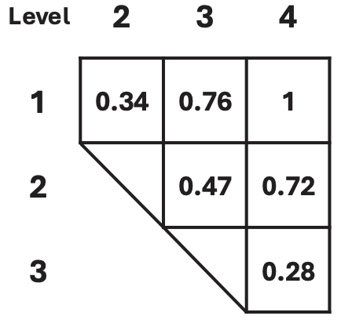
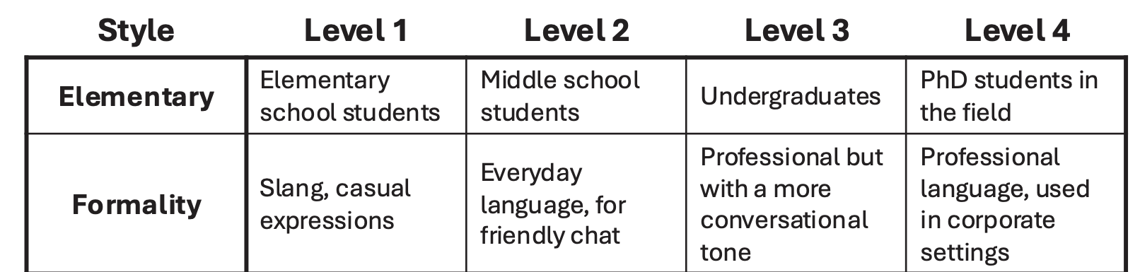
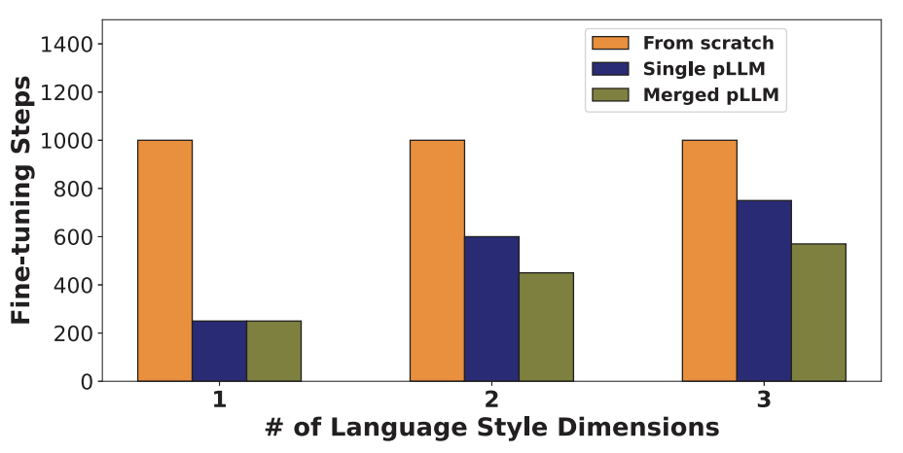
Experiment Results
Validating the Explainable Latent Space
Synthesize language style with different levels
Measure the distance of coefficeints by L1 norm
On-Device Model Merging
Personal data
Merging pLLMs
Finetuning Data for pLLMs
personal data as combinations of language styles
Notes:
In XPerT, our model selection relies on an important assumption:
Similar coefficient in the linear decomposition correspond to more similar aspects of personalization.
To validate this, we use a synthetic dataset that simulate language styles at different levels—shown in the left figure.
The right figure confirms that differences in language style levels are consistent with distances between coefficients
We also evaluate the effectiveness of on-device model merging.
In this setup, the user's personal data is a combination of multiple language styles, so no single cached pLLM is a perfect match.
As shown in the right figure, merging multiple pLLMs consistently leads to further reduction in personalization cost—
by up to 25%, compared to using only a single pLLM.

Slide 22
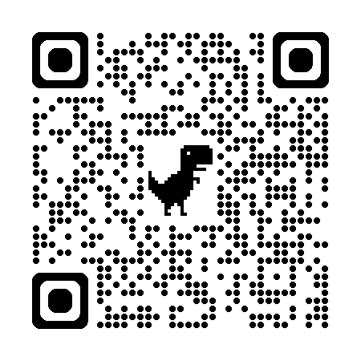
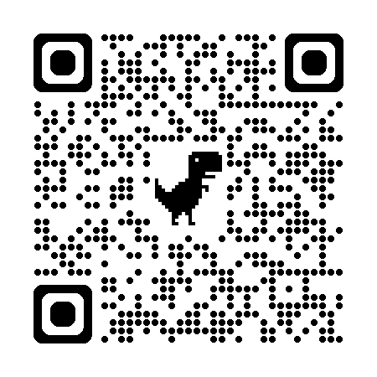
Summary
Efficient on-device LLM personalization
XPerT: fine-tune the proper pLLM cached at the cloud server with on-device personal data
Explainability for trustworthy model selection
reduce computation cost (up to 83%) and improve data efficiency (up to 51%)
QR code for more information
Lab Website
Github repo
https://pittisl.github.io/
https://github.com/pittisl/ExplainablePersonalization
(presentation slides included)
Notes:
To summarize, we propose a new technique that accelerates on-device LLM personalization by fine-tuning a well-matched pLLM cached on the cloud using the user’s personal data.
XPerT enables detailed and quantitative explainability of pLLMs, which is key to ensuring accurate and efficient model selection.
For more information, you can scan these QR codes to visit our lab website or check the source code.

Slide 23
Thank you!
Notes:
This is the end of my presentation. Thank you for listening!

Slide 24
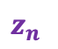
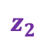
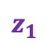
XPerT (eXplainable Personalized Tuning)
Basic Idea
- leverage a Summarization LLM to convert the pLLMs’ outputs into an explainable latent space
pLLM explanations
Informativeness
$$z_{1}$$
Expertise
1
Model Selection
0
$$z_{2}$$
Summarization LLM
……
1
pLLM
0
Formality
……
$$z_{n}$$
0
1
Explainable latent space
Explainable latent space :
Explainable
Each dimension represents an aspect of personalization with a natural language description
Quantitative
The value $(z_{i})$ represents the degree of personalization
Notes:
To achieve the two requirement, the basic idea of XPerT is to leverage a Summarization LLM to convert the pLLMs’ outputs into an explainable latent space, and the cooridinates in such space is used in model selection
To make the explainable latent space meet the two requirements before, we expect that each dimension represents an aspect of personalization with a natural language description, as shown in the green text.
Then to make it quantitative, each aspect has the corresponding value to indicate the degree of personalization

Slide 25

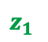
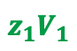
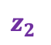
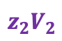
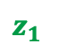
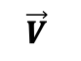
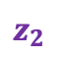
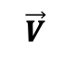
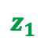
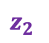
XPerT: Basic Idea
Step 1 : Quantify the output distribution drift of pLLM
Base LLM
Encode
Output distribution drift
$$\vec{V}$$
Embedding
vector
pLLM
Summarization LLM
Step 2 : Explain the embedding vector via decomposition
$$\vec{V}$$
Linearly
decompose
$$z_{1}V_{1}$$
$\vec{V}=z_{1}V_{1}$+ $z_{2}V_{2}$+ …
$$z_{2}V_{2}$$
natural language descriptions
Step 3 : Model selection based on the coefficient of decomposition
Personal data
pLLM1
pLLM2
…
…
…
…
$$z_{1}$$
$$z_{2}$$
…
$$z_{1}$$
$$z_{2}$$
…
$$z_{1}$$
$$z_{2}$$
…
Most similar
Notes:
1 we need to know how the pLLM is changed from the base model, but it’s difficult to directly compute the distance between the output distributions of two llms -> so we leverage the capability of another summarization LLM to summarize such difference -> however, if directly summarize into natural language, such difference is not quantitative, so instead we extract summarization LLM’s embedding vector in the scemantic rich embedding space.
2 the second step is to explain the embedding vector in the first step. Based on linear representation hypothesis, we can linearly decompose an embedding vector with complex meaning using a set of sub-vector, each representing a simple aspect of personalization while have natural language explanation.
3 by computing the similarity score between the coefficients of the decomposition
3

Slide 26
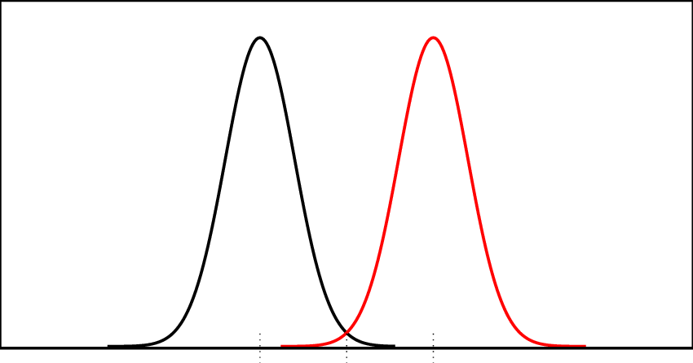
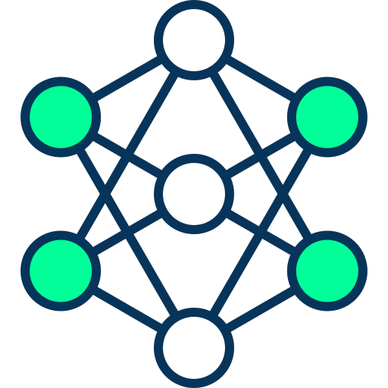

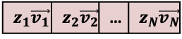

XPerT (eXplainable Personalized Tuning)
pLLM Explanations
Model Selection
Distribution shift
Summarization
LLM
Explanations of pLLMs
Personal data
Instruction
$$\vec{V}$$
Embedding
vector
Decompose
Distance calculation
Output
Distribution
Output
Distribution
$\vec{V}=z_{1}\vec{v_{1}}+z_{2}\vec{v_{2}}$…
?
Explainable latent space
Best match
Prompt samples
$$z_{1}\vec{v_{1}}$$ | $$z_{2}\vec{v_{2}}$$ | … | $$z_{N}\vec{v_{N}}$$
……
Base LLM
Style
pLLM
Expertise
Informativeness
Server
On-Device
Notes:
Here is the overview about how XPerT computes the explanation and makes model selection.
we probe both the base LLM and pLLM with the same set of prompt samples, and then employ the summarization LLM to summarize the difference of their output distributions.
To quantify such summarized difference, we first extract the embedding vector as the hidden states before the summarization LLM’s output layer. Based on existing empirical studies, which suggest that high-level concepts in a LLM are represented linearly in the LLM’s embedding space. We can decompose this embedding vector into a linear combination of orthogonal sub-vectors. Here each sub-vector represents a simple aspect of personalization (i.e., the formality of language) The coefficients is the linear decomposition serve as the quantitative measurements how much the pLLM was personalized in different aspects
On the user end, it only downloads the common set of orthogonal sub-vectors of all cached pLLMs, as well as the coordinates of these pLLMs in the explainable latent space. The user uses the same method to map its personal data to the set of sub-vectors, and selects the pLLM whose coordinate is the closest to the coordinate of its personal data

Slide 27
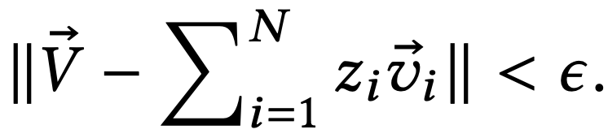





Details: Model Explanation with Quantitative measures
Decomposing the pLLM’s embedding vector
Summarization LLM
Output distribution
Embedding vector
Expert
Academic
Formal
0.04
0.11
0.32
Summarization
LLM
Input text
Base
layers
Output
layer
$$\vec{V}$$
…
…
Embedding
vector
Summarization
LLM
Generate
Formal texts
Extracting the
embedding vector
Decompose
$$D_{formal}$$
$\vec{V}=z_{1}\vec{v_{1}}+z_{2}\vec{v_{2}}$…
$$V_{formal}$$
Generate
default texts
Summarization
LLM
Summarization
LLM
$$D_{unstyled}$$
Repeat until
Notes:
1 let the summarization LLM further finish generation to propose candidates
2 use the same method to compute embedding vector for each candidate (via generation synthetic data to simulate a distribution drift caused by this candidates)

Slide 28




Details: Model Explanation with Quantitative measures
Efficient sub-vector computation:
Generate
Formal texts
Summarization
LLM
Extracting the
embedding vector
$$D_{formal}$$
Original
(summarizing from
synthetic data)
Summarization
LLM
$$V_{formal}$$
Generate
default texts
Summarization
LLM
$$D_{default}$$
Efficient
method
[Formal] +
Generation Prompt
Summarization
LLM
Difference`
$$V_{}$$
Feedback
Optimize the prompt template for sub-vector generation
Notes:
However, this method requires multiple inferences in the summarization LLM to generate stylized texts and summarize these styles, which is computationally expensive as we need to do it for every candidate word
To improve the computational efficiency, we build on the strong natural language capability of the summarization LLM, and directly prompts the summarization LLM to generate the sub-vector from a candidate word, instead of delivering the knowledge about the candidate word via the stylized texts.
To properly prompt the summarization LLM and hence minimize the error in the generated sub-vector. we first apply offline prompt tuning to optimize this prompt as trainable embeddings while the sub-vectors generated by the original method are the ground truth of prompt tuning, and then use the optimized prompt for online sub-vector generation

Slide 29




Details of XPerT: On-device model selection
…
Layer N-1
Personal data
Explanations of pLLMs
Distance calculation
Summarization LLM
Outputs N-1
Layer N
Outputs N
On-Device
?
Layer N+1
Best match
Model partition to fit summarization LLM
into mobile device’s memory
If best matching pLLM largely mismatches
$$α_{i}$$
$$×$$
+
=
$$α_{j}$$
$$×$$
merge multiple pLLMs:
$θ_{base}+α_{i}\left(θ_{pLLM}^{i}−θ_{base}\right)+$ $α_{j}(θ_{pLLM}^{j}−θ_{base})$
Notes:
In the model selection phase, the user needs to map their personal data to the same latent space, which involves running the summarization LLM on the device. However, this model has a large parameter size and may not fit within the memory constraints of mobile devices.
To address this, we can partition the summarization LLM and perform inference one layer at a time. The output of each layer is cached in memory and used as the input to the next layer.
Since the task only involves predicting the next token, each layer of the summarization LLM only needs to be loaded and executed once. As a result, the overhead of loading and switching between layers can be minimized.
If the best-matching pLLM still does not align well with the user’s personal data, we can merge multiple pLLMs personalized for different aspects to better reflect the user’s local context. This is done by directly modifying their parameters using arithmetic operations. The coordinates in the latent space can then help determine the coefficients used in model merging.

